Slide 1
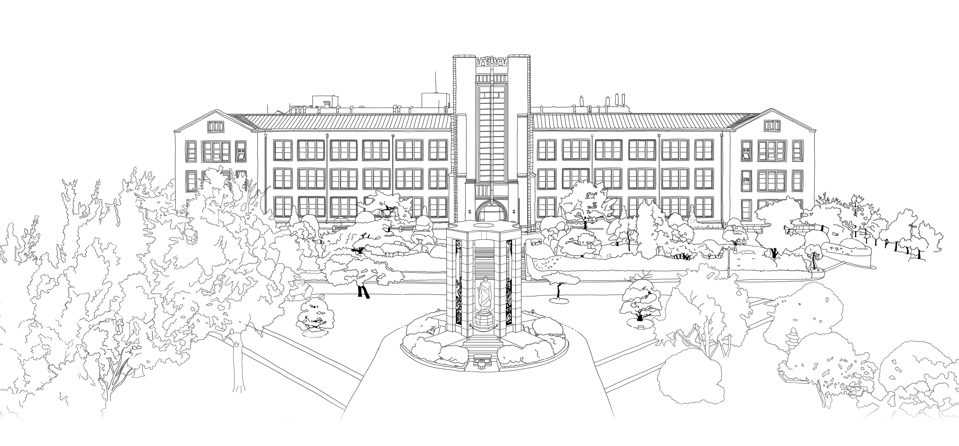
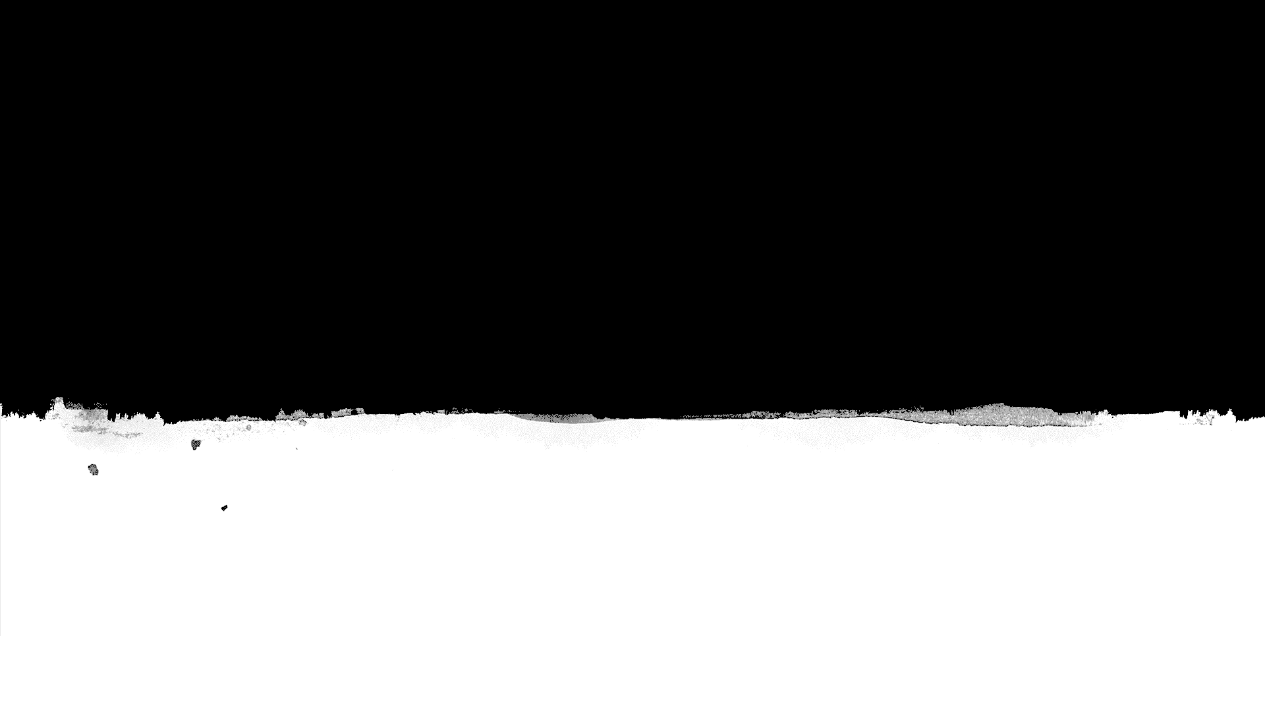

Introduction to Algorithms
DongYeon Kim
Department of Multimedia Engineering
Dongguk University

Slide 2
Contents
Chapter.2 Sorting and Order Statistics
Heapsort
Heaps
Maintaining the heap property
Building a heap
The heapsort algorithm
Priority queues
Quicksort
Description of quicksort
Performance of quicksort
A randomized version of quicksort
Sorting in Linear Time
Counting sort
Radix sort
Bucket sort
Medians and Order Statistics
Minimum and maximum
Selection in expected linear time
Selection in worst-case linear time

Slide 3
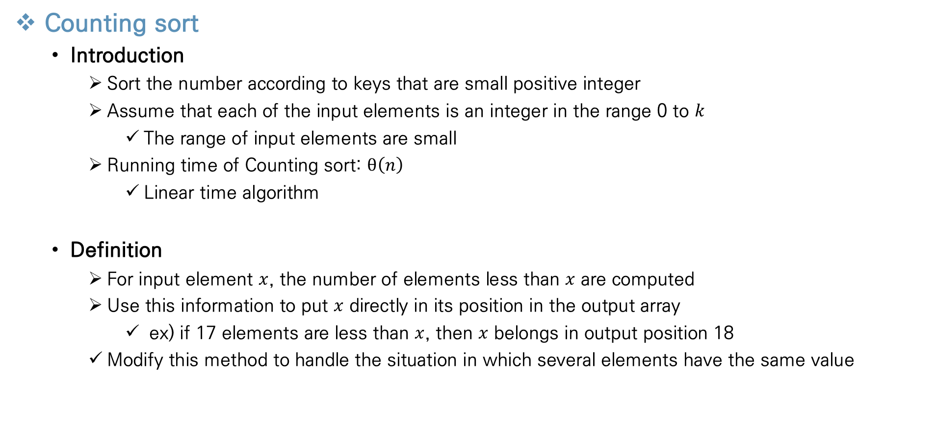
Sorting in Linear Time
Counting sort
Introduction
Sort the number according to keys that are small positive integer
Assume that each of the input elements is an integer in the range 0 to $k$
The range of input elements are small
Running time of Counting sort: $θ\left(n\right)$
Linear time algorithm
Definition
For input element $x$, the number of elements less than $x$ are computed
Use this information to put $x$ directly in its position in the output array
ex) if 17 elements are less than $x$, then $x$ belongs in output position 18
Modify this method to handle the situation in which several elements have the same value

Slide 4
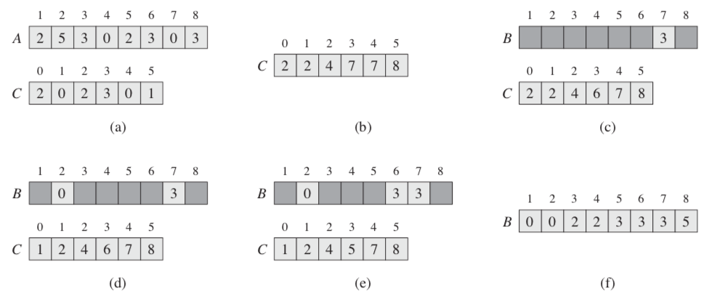
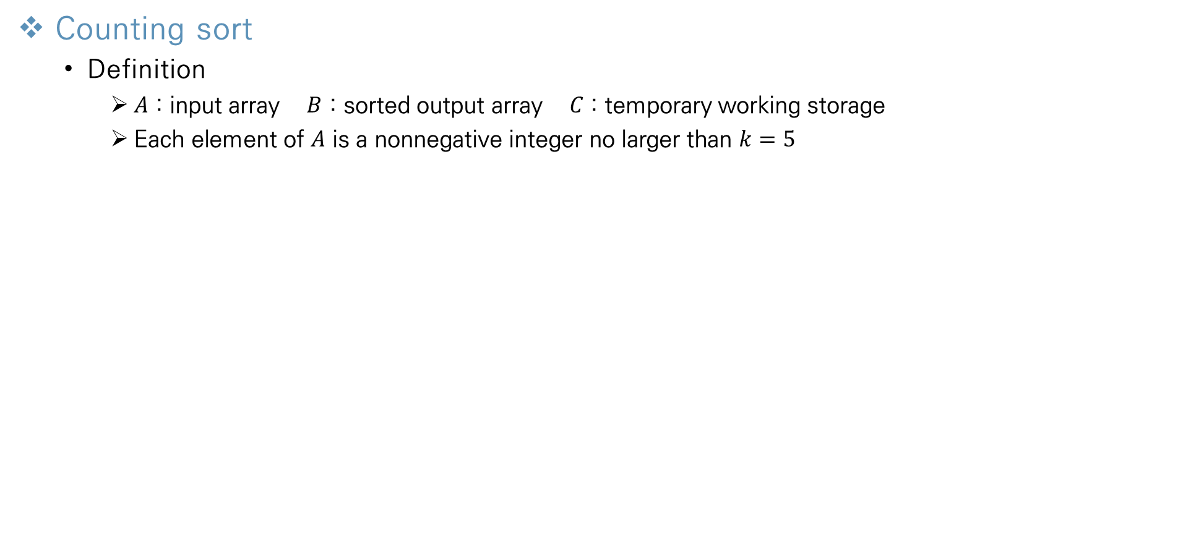
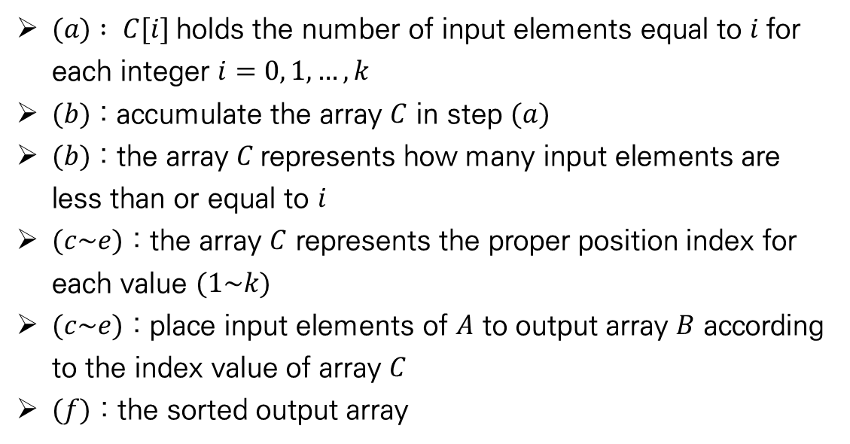
Sorting in Linear Time
Counting sort
Definition
$A$ : input array $B$ : sorted output array $C$ : temporary working storage
Each element of $A$ is a nonnegative integer no larger than $k=5$
$(a) : C[i]$holds the number of input elements equal to $i$for each integer $i=0, 1,…,k$
$(b)$ : accumulate the array $C$ in step $(a)$
$(b)$ : the array $C$represents how many input elements are less than or equal to $i$
$(c\sim e)$ : the array $C$ represents the proper position index for each value $(1\sim k)$
$(c\sim e)$ : place input elements of $A$ to output array $B$ according to the index value of array $C$
$(f)$ : the sorted output array

Slide 5
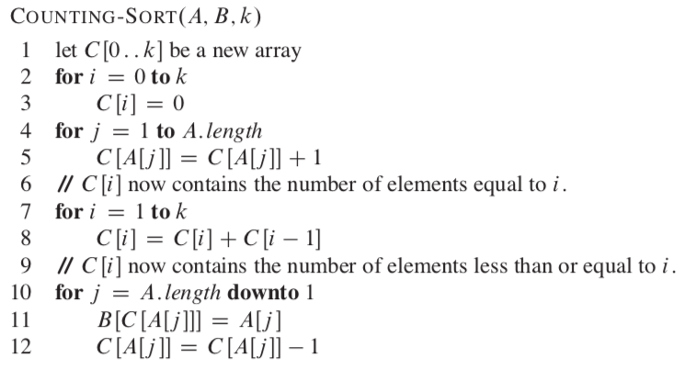
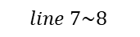

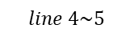
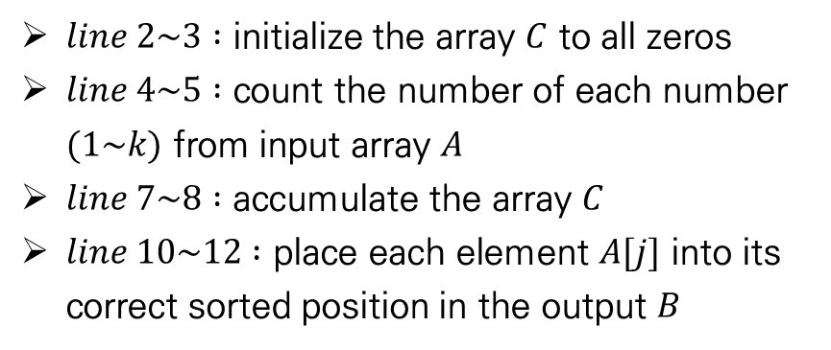
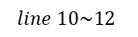
Sorting in Linear Time
Counting sort
Pseudocode
$A$ : input array $B$ : sorted output array $C$ : temporary working storage
Each element of $A$ is a nonnegative integer no larger than $k=5$
$line 2\sim 3 :$ initialize the array $C$ to all zeros
$line 4\sim 5 :$ count the number of each number $(1\sim k)$ from input array $A$
$line 7\sim 8 :$ accumulate the array $C$
$line 10\sim 12 :$ place each element $A[j]$ into its correct sorted position in the output $B$
$$line 4\sim 5$$
$$line 7\sim 8$$
$$line 10\sim 12$$

Slide 6
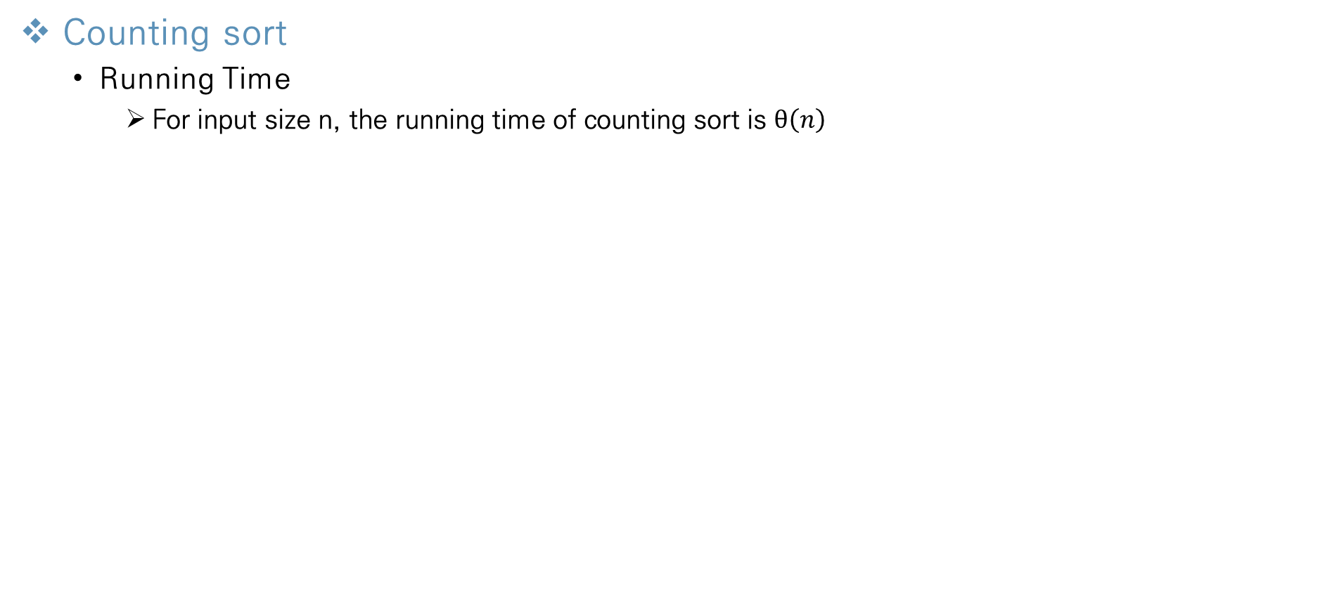
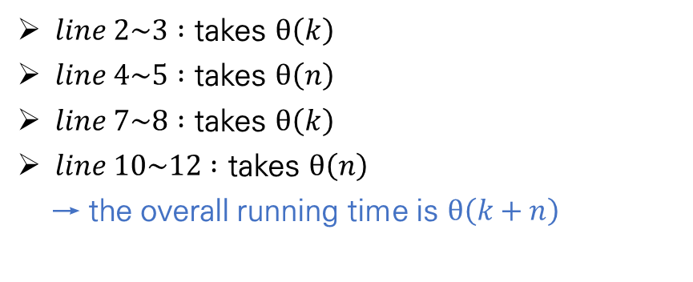
Sorting in Linear Time
Counting sort
Running Time
For input size n, the running time of counting sort is $θ\left(n\right)$
$line 2\sim 3 :$ takes $θ\left(k\right)$
$line 4\sim 5 :$ takes $θ\left(n\right)$
$line 7\sim 8 :$ takes $θ\left(k\right)$
$line 10\sim 12 :$ takes $θ\left(n\right)$
→ the overall running time is $θ\left(k+n\right)$
→ we usually use counting sort when $k=O(n)$, because the performance of counting sort is up to constant $k$

Slide 7
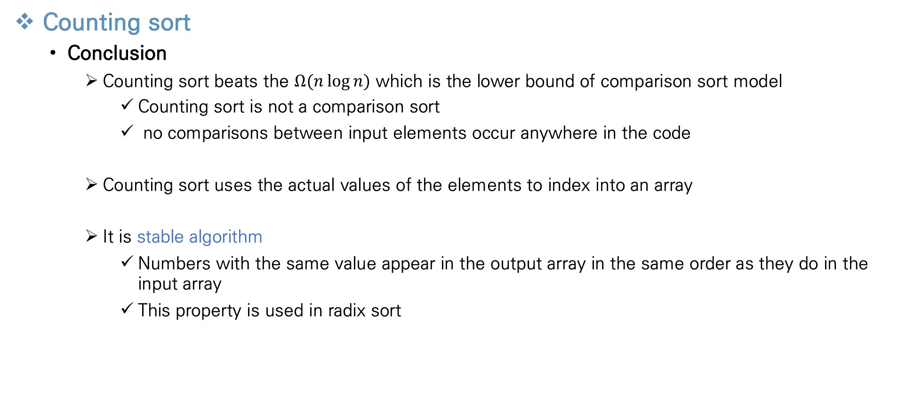
Sorting in Linear Time
Counting sort
Conclusion
Counting sort beats the $Ω(n\log{n})$ which is the lower bound of comparison sort model
Counting sort is not a comparison sort
no comparisons between input elements occur anywhere in the code
Counting sort uses the actual values of the elements to index into an array
It is stable algorithm
Numbers with the same value appear in the output array in the same order as they do in the input array
This property is used in radix sort

Slide 8
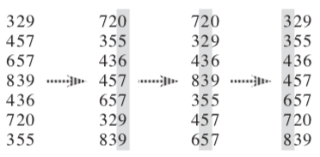
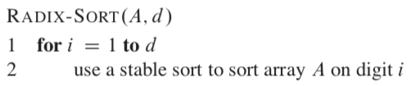
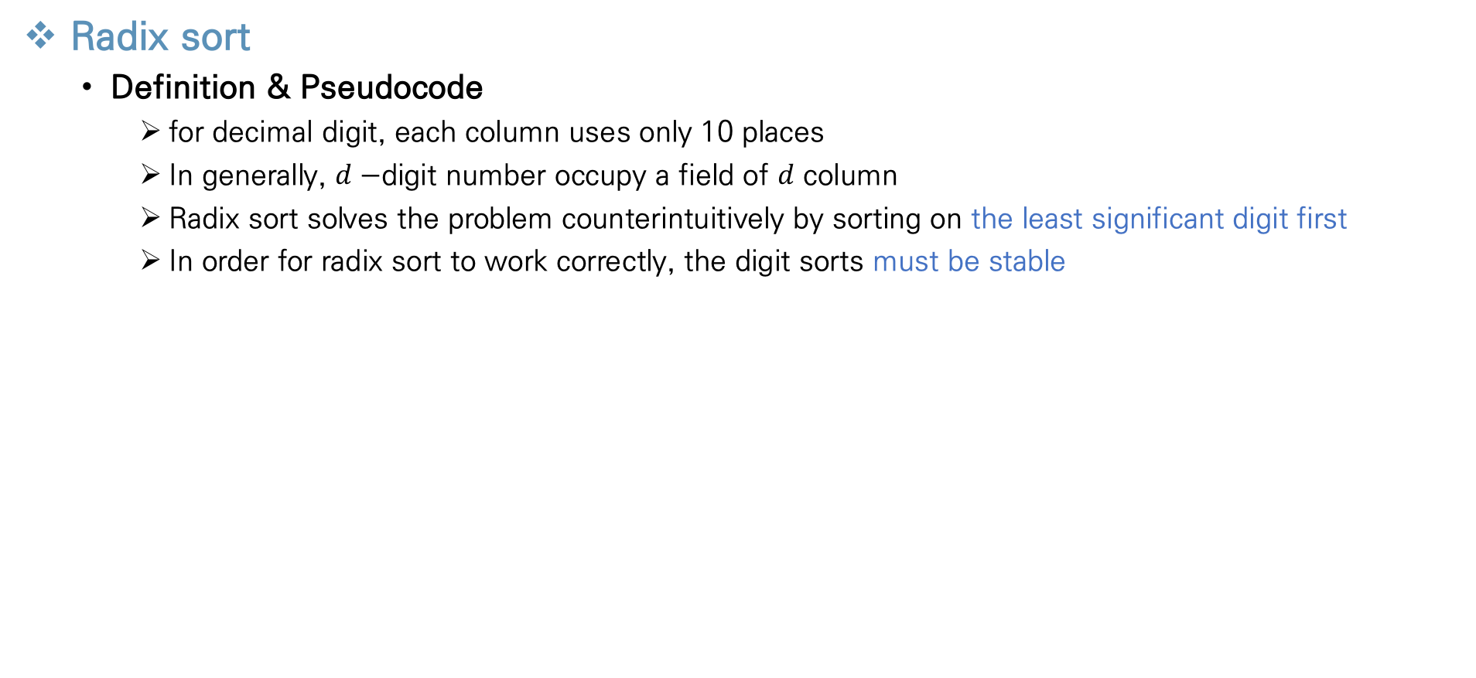
Sorting in Linear Time
Radix sort
Definition & Pseudocode
for decimal digit, each column uses only 10 places
In generally, $d−$digit number occupy a field of $d$ column
Radix sort solves the problem counterintuitively by sorting on the least significant digit first
In order for radix sort to work correctly, the digit sorts must be stable

Slide 9
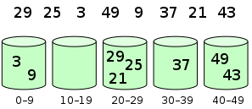
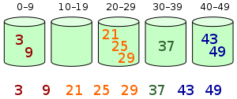
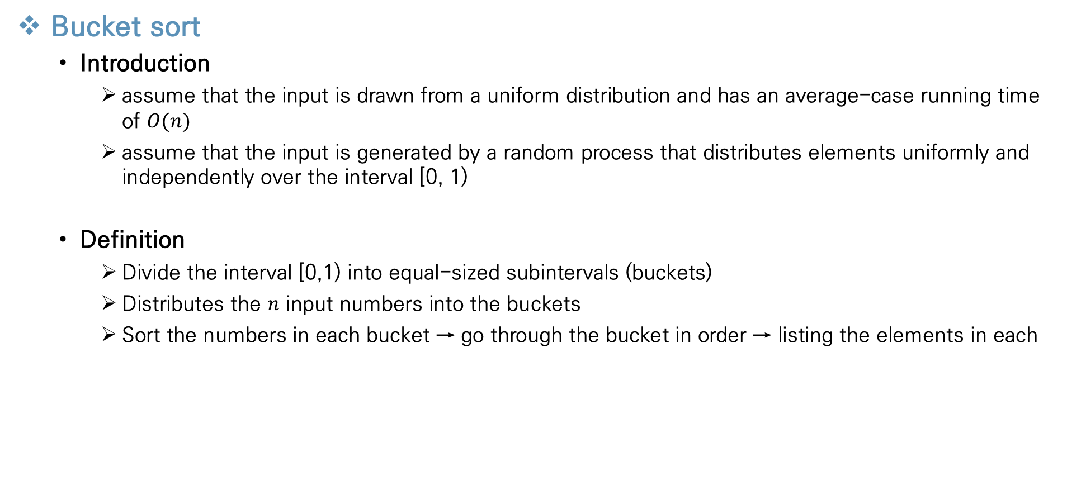
Sorting in Linear Time
Bucket sort
Introduction
assume that the input is drawn from a uniform distribution and has an average-case running time of $O(n)$
assume that the input is generated by a random process that distributes elements uniformly and independently over the interval [0, 1)
Definition
Divide the interval [0,1) into equal-sized subintervals (buckets)
Distributes the $n$ input numbers into the buckets
Sort the numbers in each bucket → go through the bucket in order → listing the elements in each
Notes:
Since the inputs are uniformly and independently distributed over [0,1), we do not expect many numbers to fall into each bucket

Slide 10
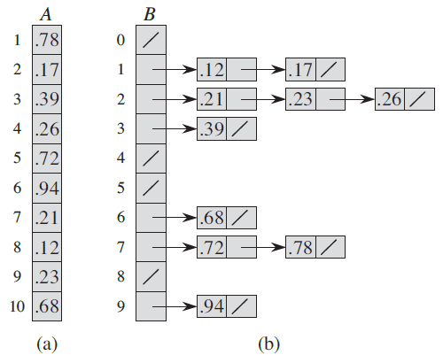
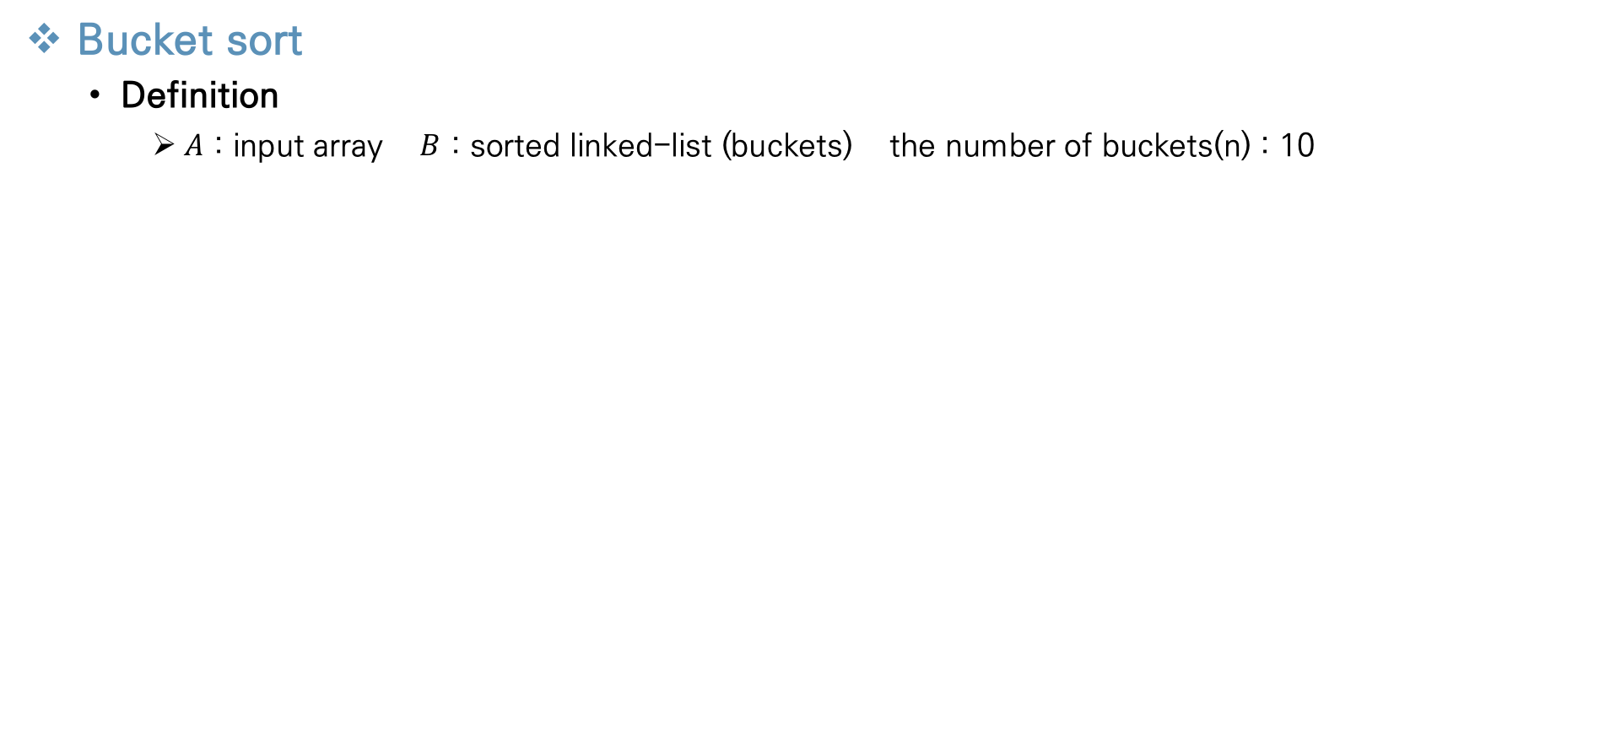
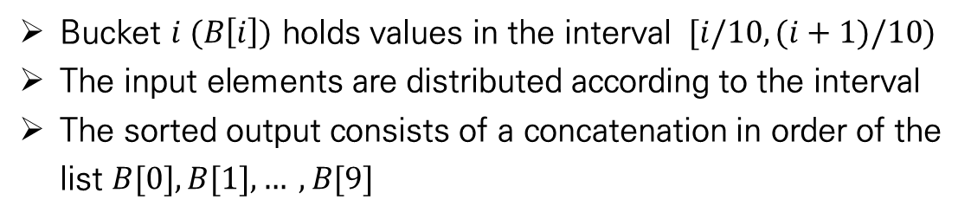
Sorting in Linear Time
Bucket sort
Definition
$A$ : input array $B$ : sorted linked-list (buckets) the number of buckets(n) : 10
Bucket $i (B\left[i\right])$ holds values in the interval $[i/10, (i+1)/10)$
The input elements are distributed according to the interval
The sorted output consists of a concatenation in order of the list $B[0], B[1], … , B[9]$

Slide 11
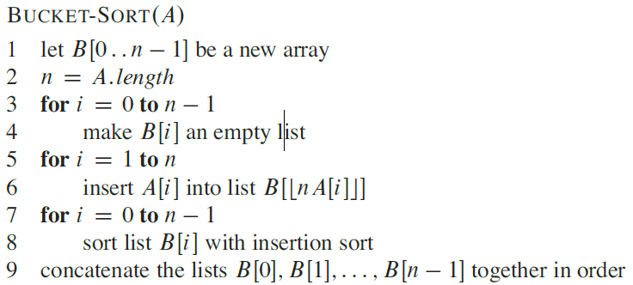
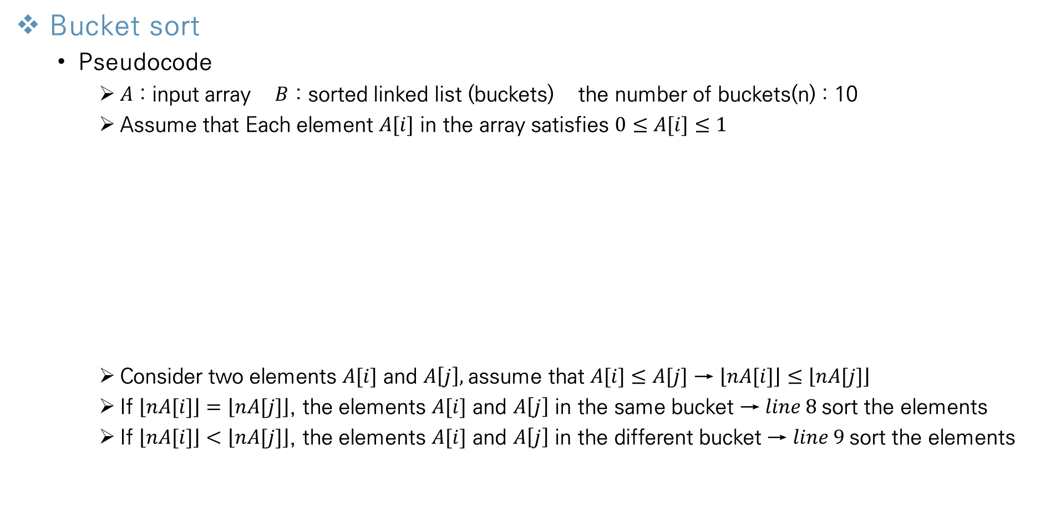
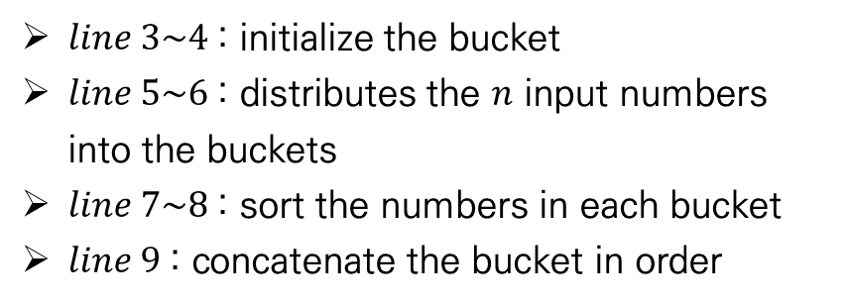
Sorting in Linear Time
Bucket sort
Pseudocode
$A$ : input array $B$ : sorted linked list (buckets) the number of buckets(n) : 10
Assume that Each element $A[i]$ in the array satisfies $0≤A[i]≤1$
Consider two elements $A[i]$ and $A\left[j\right],$assume that $A[i]≤A[j]$ → $\left\lfloor nA[i]\right\rfloor ≤\left\lfloor nA[j]\right\rfloor$
If $\left\lfloor nA[i]\right\rfloor =\left\lfloor nA[j]\right\rfloor$, the elements $A[i]$ and $A\left[j\right]$ in the same bucket → $line 8$sort the elements
If $\left\lfloor nA[i]\right\rfloor <\left\lfloor nA[j]\right\rfloor$, the elements $A[i]$ and $A\left[j\right]$ in the different bucket → $line 9$sort the elements
$line 3\sim 4$: initialize the bucket
$line 5\sim 6$: distributes the $n$ input numbers into the buckets
$line 7\sim 8$: sort the numbers in each bucket
$line 9$: concatenate the bucket in order
→ bucket sort works correctly

Slide 12
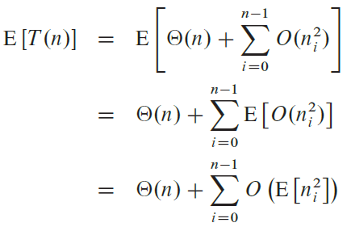
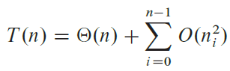
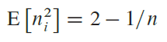
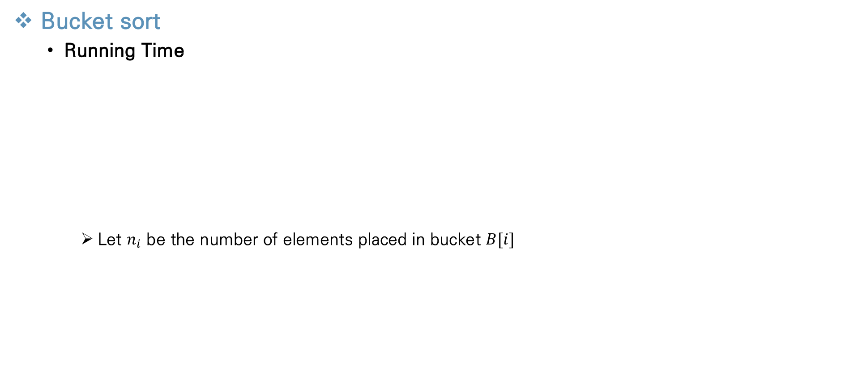
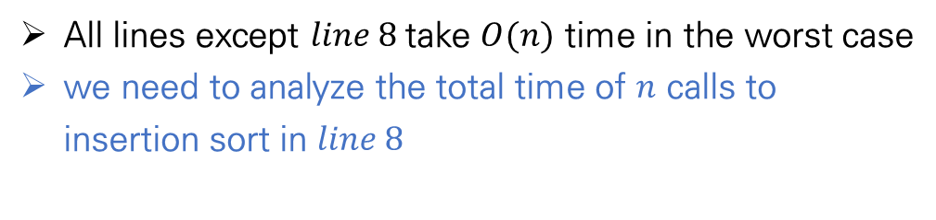
Sorting in Linear Time
Bucket sort
Running Time
Let $n_{i}$ be the number of elements placed in bucket $B[i]$
All lines except $line 8$take $O(n)$ time in the worst case
we need to analyze the total time of $n$ calls to insertion sort in $line 8$
Notes:
Even if the input is not drawn from a uniform distribution, bucket sort may still run in linear time.

Slide 13
Contents
Chapter.2 Sorting and Order Statistics
Heapsort
Heaps
Maintaining the heap property
Building a heap
The heapsort algorithm
Priority queues
Quicksort
Description of quicksort
Performance of quicksort
A randomized version of quicksort
Sorting in Linear Time
Counting sort
Radix sort
Bucket sort
Medians and Order Statistics
Minimum and maximum
Selection in expected linear time
Selection in worst-case linear time

Slide 14
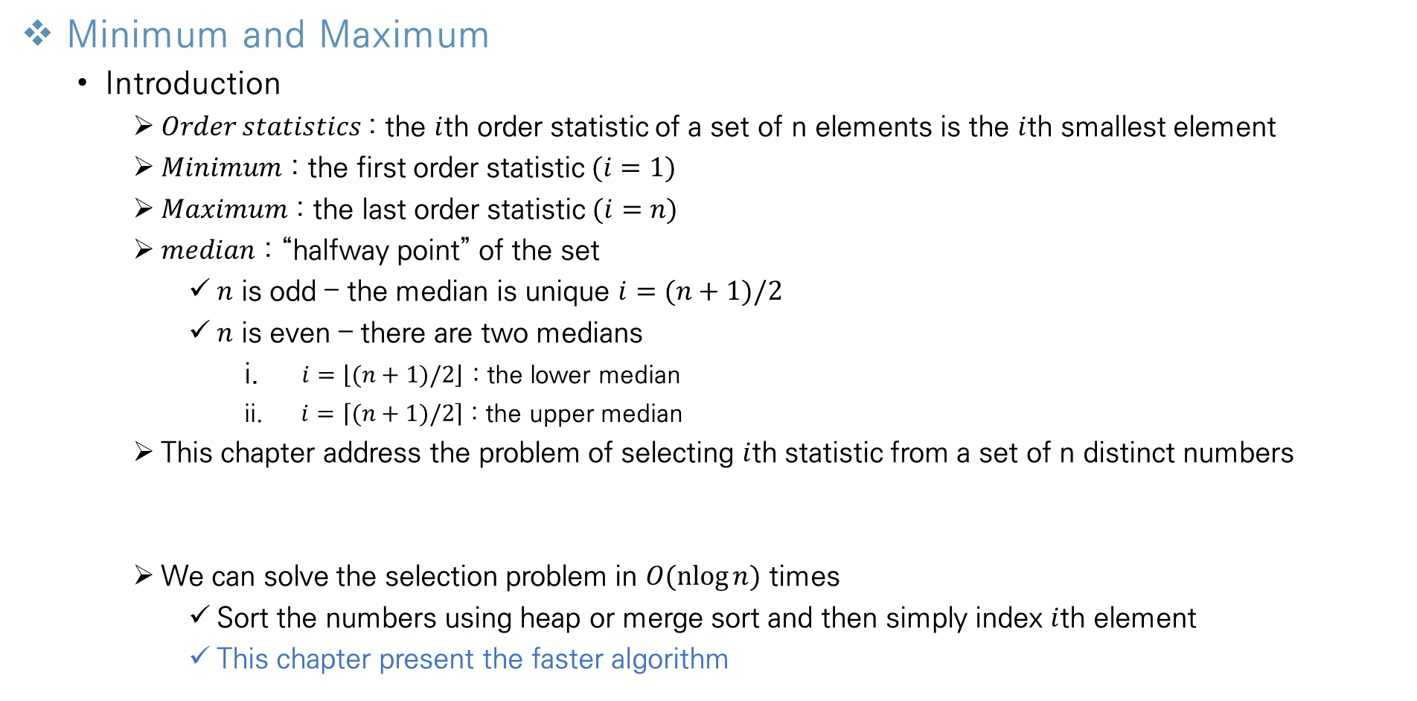
Medians and Order Statistics
Minimum and Maximum
Introduction
$Order statistics$: the $i$th order statistic of a set of n elements is the $i$th smallest element
$Minimum$ : the first order statistic $(i=1)$
$Maximum$ : the last order statistic$(i=n)$
$median$ : “halfway point” of the set
$n$ is odd – the median is unique $i=(n+1)/2$
$n$ is even – there are two medians
$i=\left\lfloor (n+1)/2\right\rfloor$ : the lower median
$i=\left\lceil (n+1)/2\right\rceil$ : the upper median
This chapter address the problem of selecting $i$th statistic from a set of n distinct numbers
We can solve the selection problem in $O(\operatorname{nlog}{n})$ times
Sort the numbers using heap or merge sort and then simply index $i$th element
This chapter present the faster algorithm

Slide 15
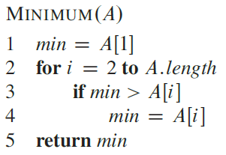
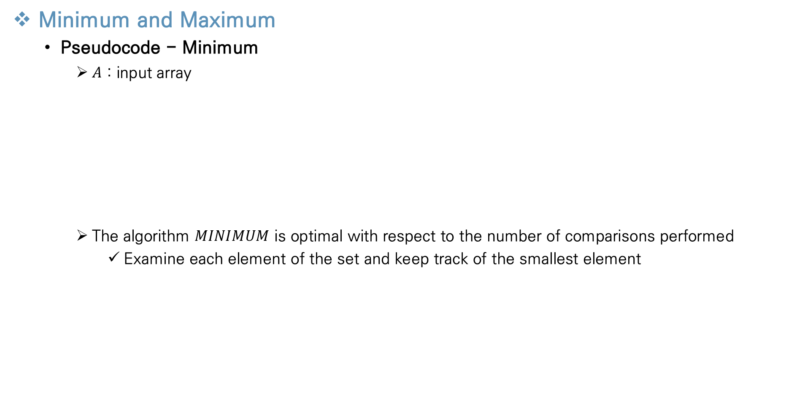
Medians and Order Statistics
Minimum and Maximum
Pseudocode - Minimum
$A$ : input array
The algorithm $MINIMUM$ is optimal with respect to the number of comparisons performed
Examine each element of the set and keep track of the smallest element
Easily obtain an upper bound of n-1 comparisons
Examine each element of the set and keep track of the smallest element

Slide 16
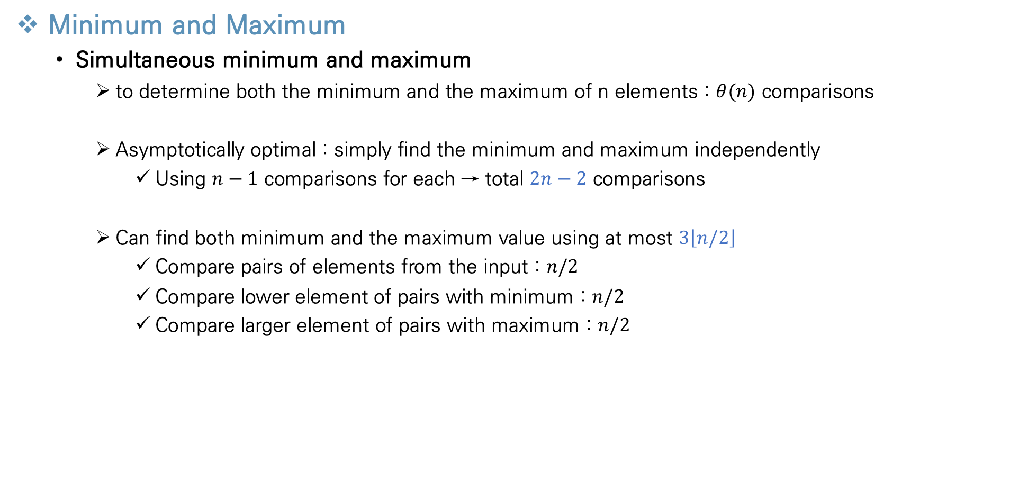
Medians and Order Statistics
Minimum and Maximum
Simultaneous minimum and maximum
to determine both the minimum and the maximum of n elements : $θ(n)$ comparisons
Asymptotically optimal : simply find the minimum and maximum independently
Using $n−1$ comparisons for each → total $2n−2$ comparisons
Can find both minimum and the maximum value using at most $3\left\lfloor n/2\right\rfloor$
Compare pairs of elements from the input : $n/2$
Compare lower element of pairs with minimum : $n/2$
Compare larger element of pairs with maximum : $n/2$
→ total $3n/2$, in even case $3\left\lfloor n/2\right\rfloor$

Slide 17
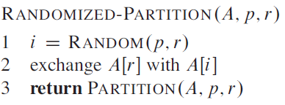
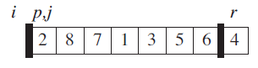
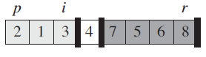
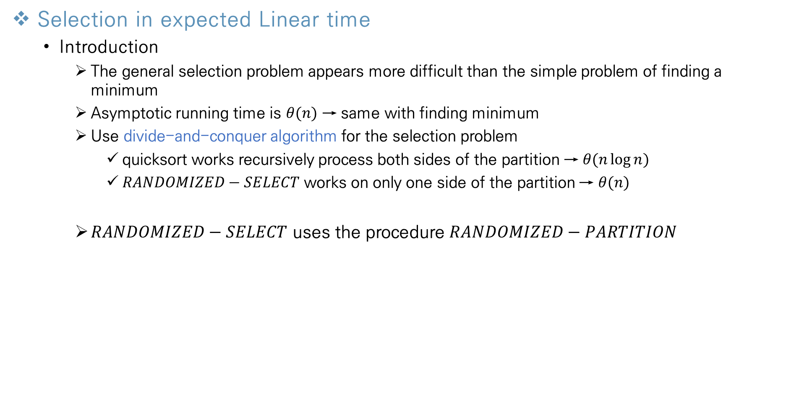
Medians and Order Statistics
Selection in expected Linear time
Introduction
The general selection problem appears more difficult than the simple problem of finding a minimum
Asymptotic running time is $θ(n)$ → same with finding minimum
Use divide-and-conquer algorithm for the selection problem
quicksort works recursively process both sides of the partition → $θ(n\log{n})$
$RANDOMIZED−SELECT$ works on only one side of the partition → $θ(n)$
$RANDOMIZED−SELECT$ uses the procedure $RANDOMIZED−PARTITION$

Slide 18
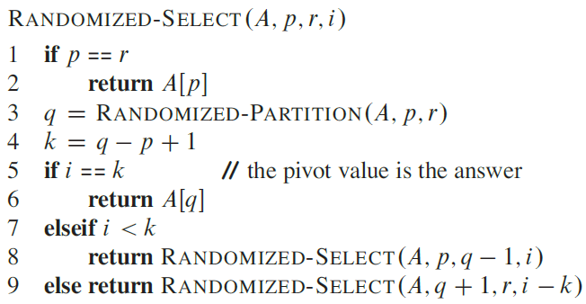
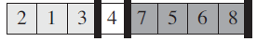
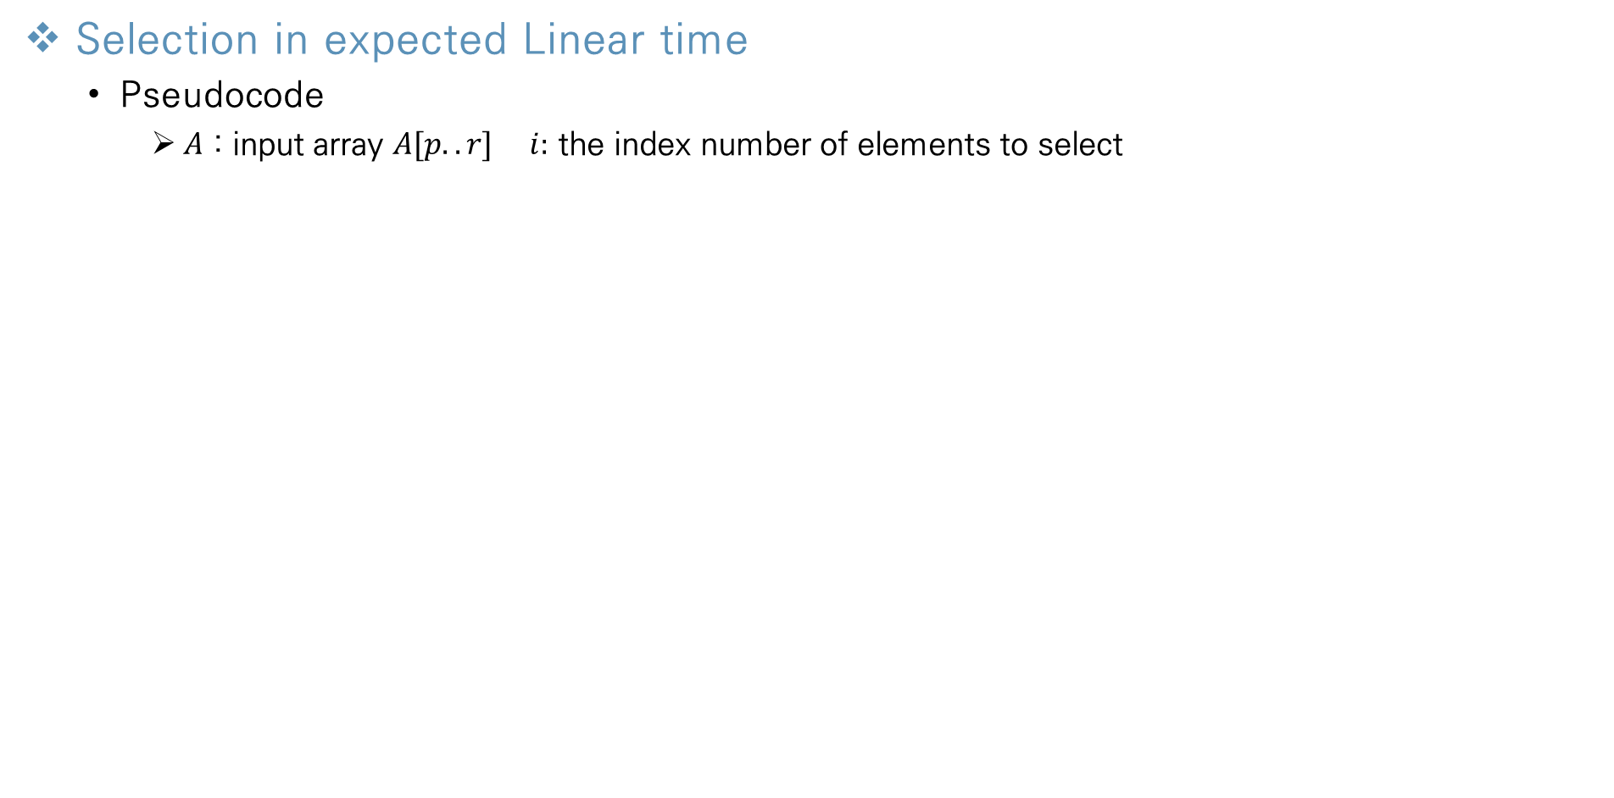
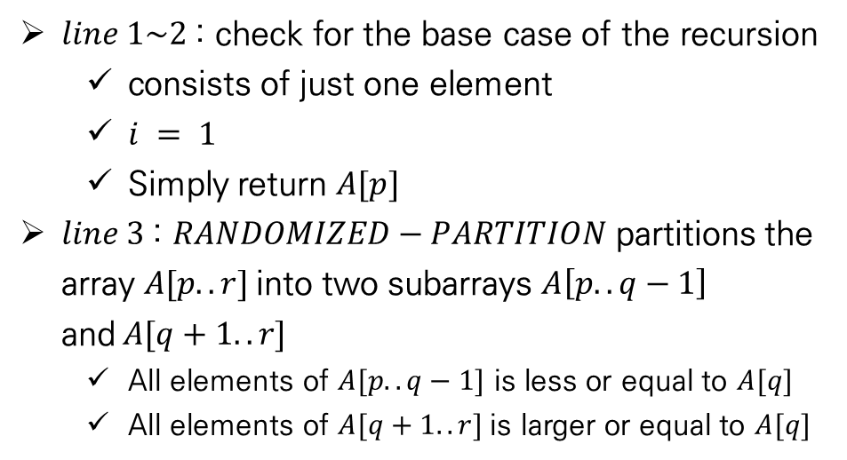
Medians and Order Statistics
Selection in expected Linear time
Pseudocode
$A$ : input array $A[p..r]$ $i:$ the index number of elements to select
$line 1\sim 2$: check for the base case of the recursion
consists of just one element
$i = 1$
Simply return $A[p]$
$line 3$: $RANDOMIZED−PARTITION$ partitions the array $A[p..r]$into two subarrays $A\left[p..q−1\right]$ and$A[q+1..r]$
All elements of $A[p..q−1]$ is less or equal to $A[q]$
All elements of $A[q+1..r]$is larger or equal to $A[q]$
p
q
r

Slide 19
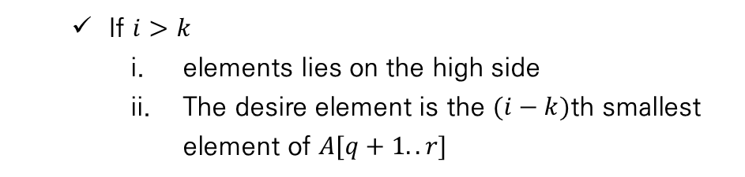
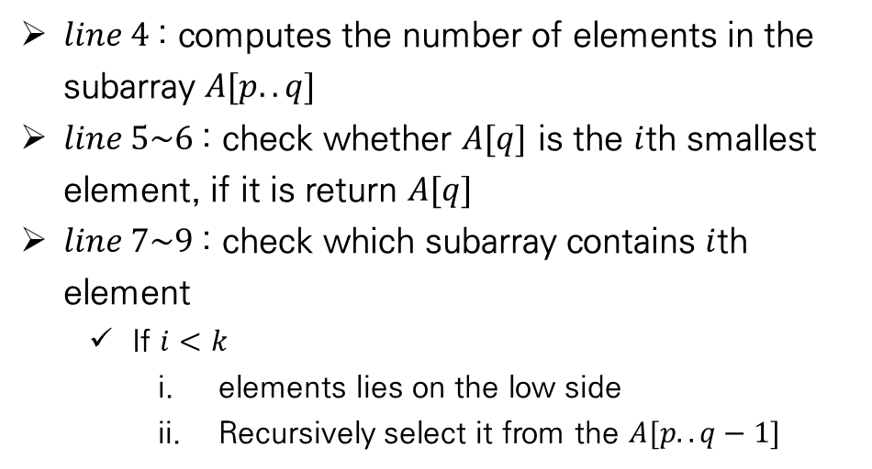
Medians and Order Statistics
Selection in expected Linear time
Pseudocode
$A$ : input array $A[p..r]$ $i:$ the index number of elements to select
$line 4$: computes the number of elements in the subarray $A[p..q]$
$line 5\sim 6$: check whether $A[q]$ is the $i$th smallest element, if it is return $A[q]$
$line 7\sim 9$: check which subarray contains $i$th element
If $i<k$
elements lies on the low side
Recursively select it from the $A[p..q−1]$
If $i>k$
elements lies on the high side
The desire element is the $(i−k)$th smallest element of $A[q+1..r]$
p
q
r
Notes:
we already
know k values that are smaller than the i th smallest element of AOEp : : r$—

Slide 20
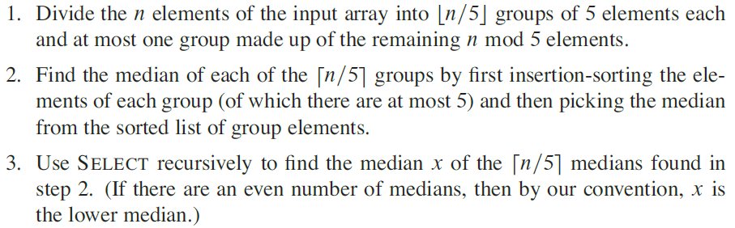
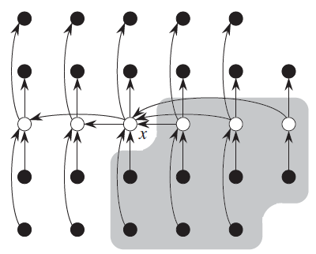
Medians and Order Statistics
Selection in worst-case Linear time
Introduction
In this chapter, examine a selection algorithm in the worst case
Guarantee a good split upon partitioning the array
definition

Slide 21
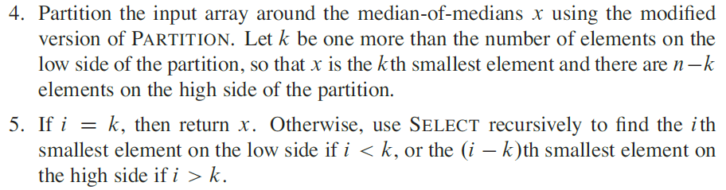
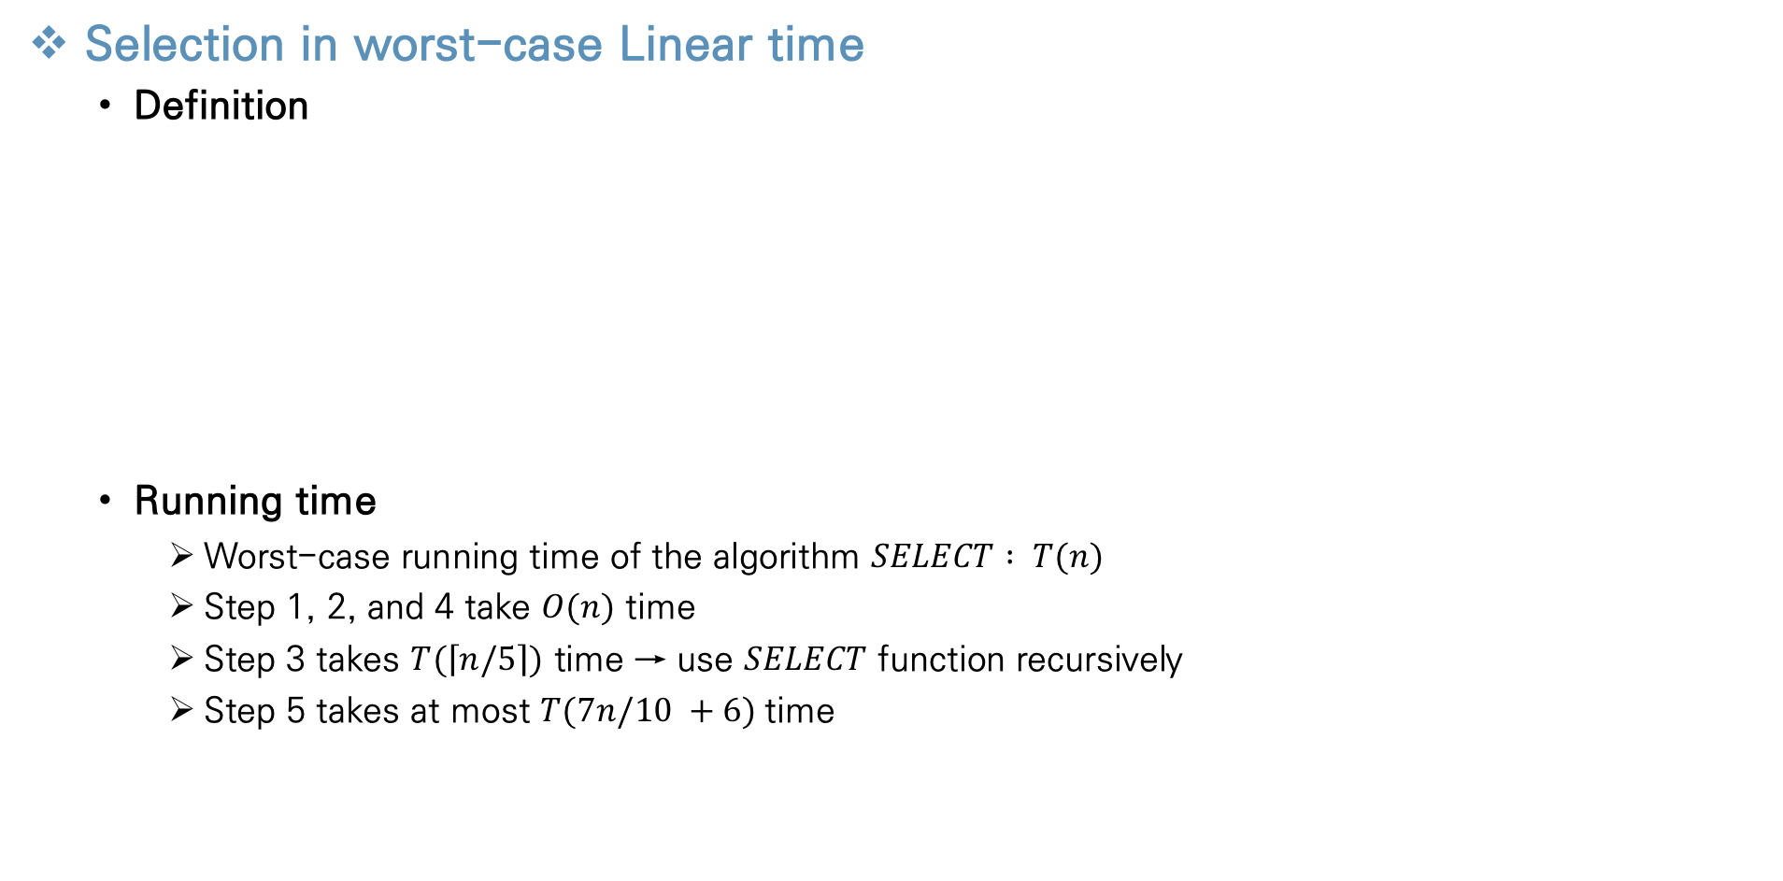
Medians and Order Statistics
Selection in worst-case Linear time
Definition
Running time
Worst-case running time of the algorithm $SELECT : T(n)$
Step 1, 2, and 4 take $O(n)$ time
Step 3 takes $T(\left\lceil n/5\right\rceil )$ time → use $SELECT$ function recursively
Step 5 takes at most $T(7n/10 +6)$time

Slide 22
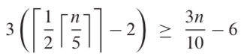



Medians and Order Statistics
Selection in worst-case Linear time
Running time
Step 5 takes at most $T(7n/10 +6)$time
Already know $3n/10−6$elements are larger than median $x$
Only partition in $n−(3n/10−6)=7n/10+6$elements
$T\left(n\right)≤T\left(\left\lceil \frac{n}{5}\right\rceil \right)+T\left(\frac{7n}{10}+6\right)+O(n)$
Assume $T(n)≤cn$ → linear time algorithm
The number of groups larger than median
Except the median & last group
→ for large constant c, the worst-case running time of $SELECT$ is linear
Notes:
we already
know k values that are smaller than the i th smallest element of AOEp : : r$—

Slide 23
Thank You!

